Slide 1
A Multiverse of analyses of multiple sclerosis data
Max Korbmacher, PhD
7 March 2025
Notes:
Today I would like to talk about the implementation of multiverse or specification curve analysis to multiple sclerosis.
I will talk about both the reasoning behind using this non-conventional method, and a concrete exampe where we applied it.

Slide 2
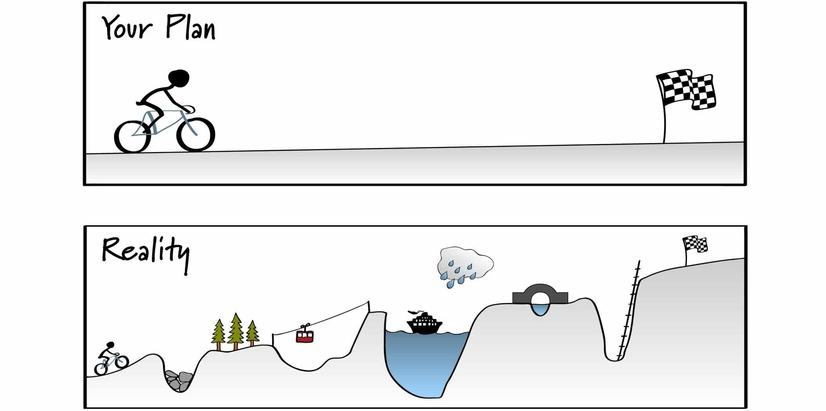
https://es.unisg.ch/en/blog/plan-vs-reality-from-career-planning-to-career-implementation/
Notes:
First, I want you to think back to your most recent research project.
Maybe it has been some time, but either way.
You had the perfect plan, you followed it. End of story.

Slide 3
https://es.unisg.ch/en/blog/plan-vs-reality-from-career-planning-to-career-implementation/
Notes:
Or was it more like that?
Fun aside, most projects look like the lower panel. And this is also an important part of discovery or exploratory research.
However, paired with the current incentive system, such a process led to some problems in the literature.
What do I mean by that?

Slide 4
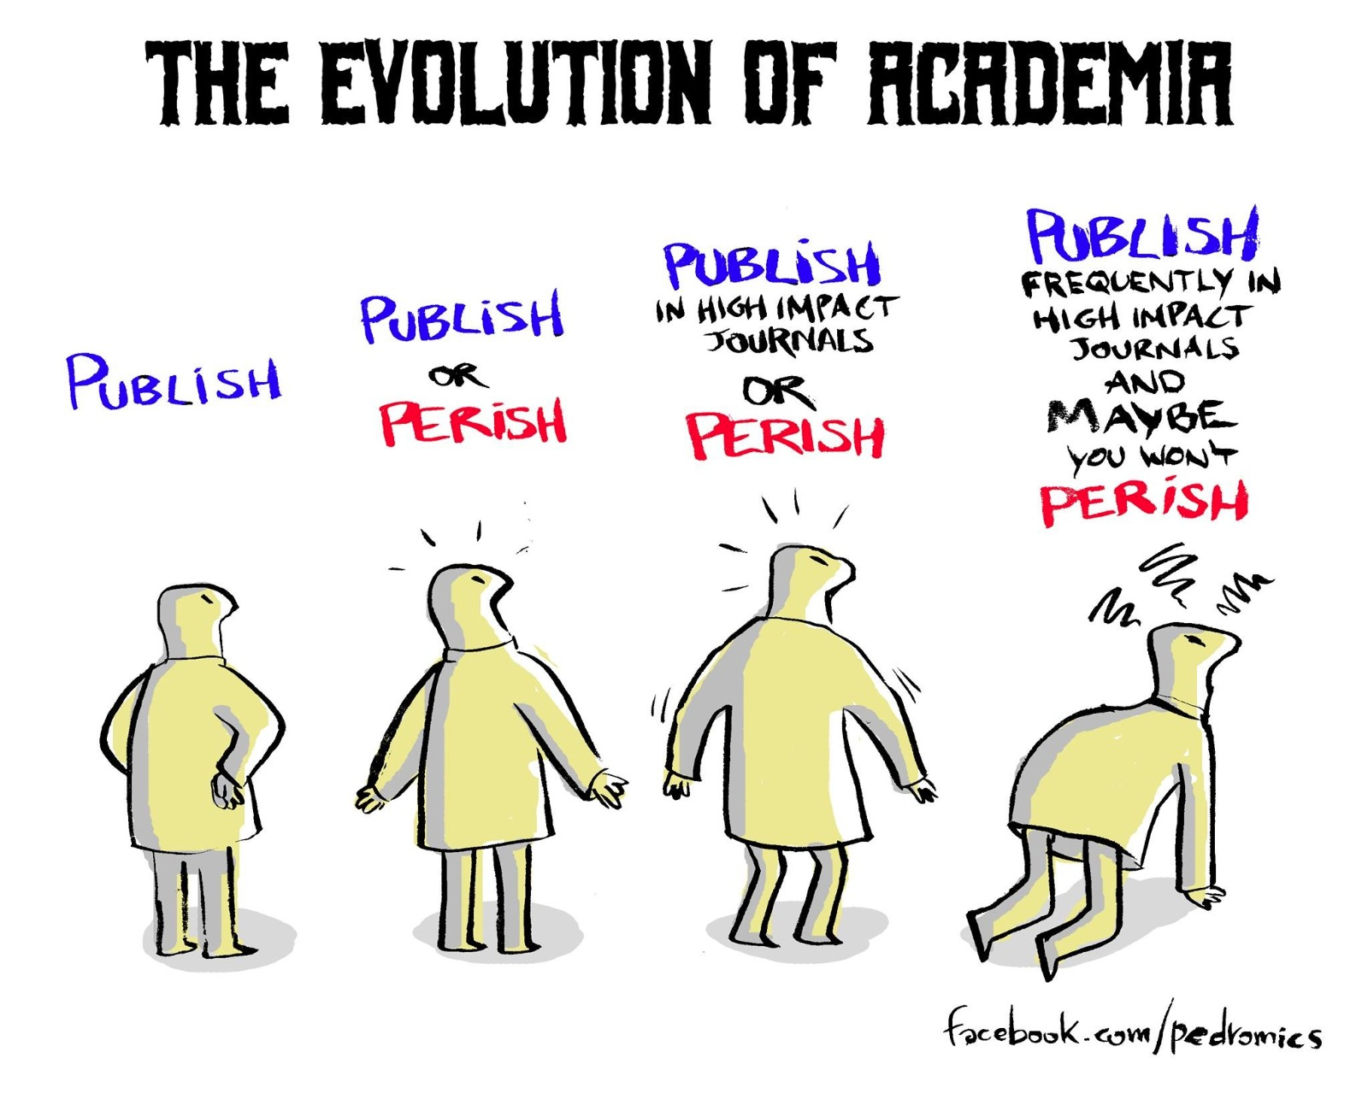
Notes:
The main currency in academic research are probably publications, grants, titles
The number of these are correlated, and the Matthew effect applies: «Those who have will be given, and vice versa»
All of us know «publish or perish» and that journal «impact» and other silly metrics are important
In brief, the system is not optimal.
It puts pressure on people, might encourage poor decision making during the research process, etc.

Slide 5
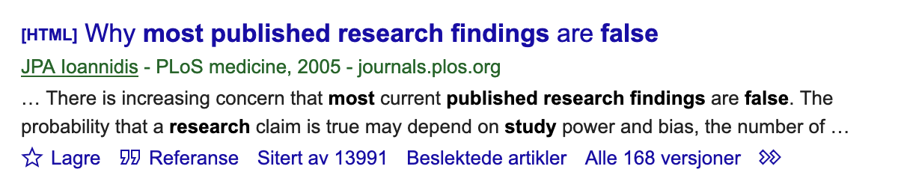
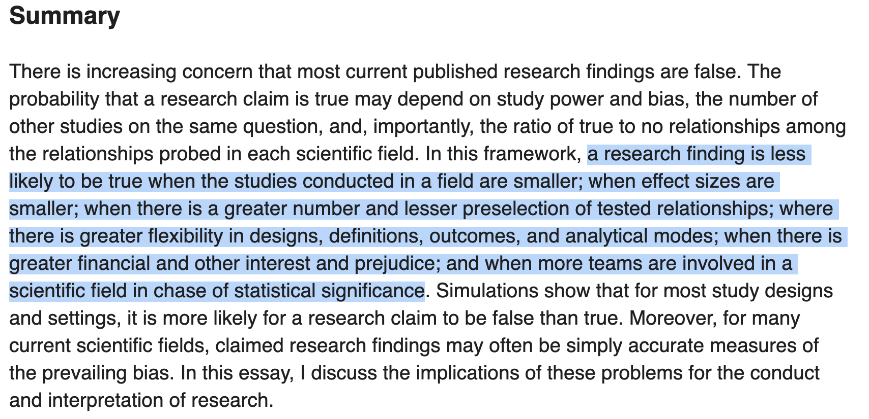
Notes:
Many poor decisions have led to a skewed literature full of false positives.
There are many reasons for that
Some are excellently summarized by Ioannidis

Slide 6
But are things really that bad?
Notes:
But are things really that bad?
There are many ways to assess the state of the literature.
One is to use replications.

Slide 7
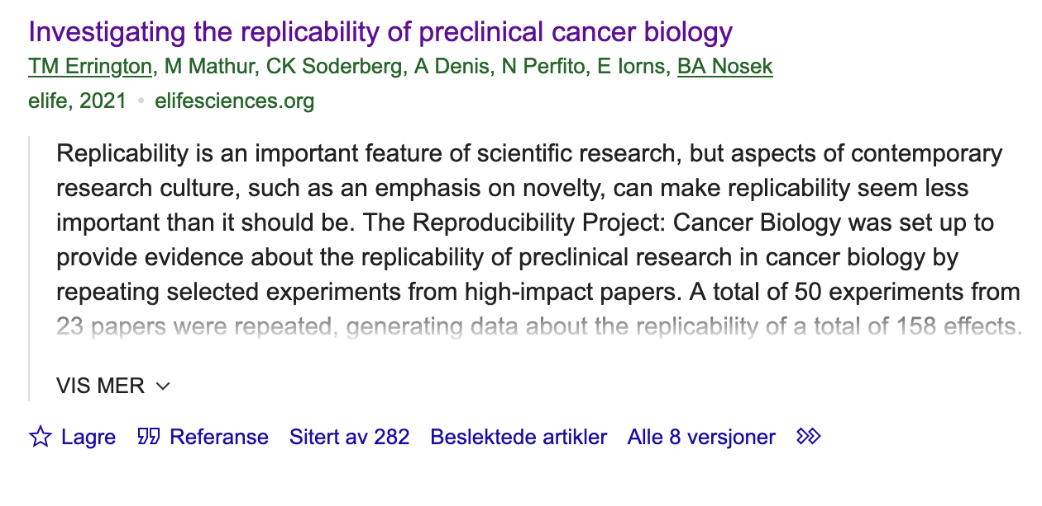
But are things really that bad?
It depends…
50 replicated experiments from 23 papers, generating data on 158 effects.
“For positive effects, 40% of replications (39/97) succeeded […], and for null effects 80% of replications (12/15) were successful […]; combining positive and null effects, the success rate was 46% (51/112)."
Notes:
Here, in a cancer biology replication project 50 experiments from 23 papers were replicated, featuring158 effects
“For positive effects, 40% of replications (39/97) succeeded […], and for null effects 80% of replications (12/15) were successful […]; combining positive and null effects, the success rate was 46% (51/112)."
This has also been called the replication crisis, as we very much struggle to replicate findings independently

Slide 8
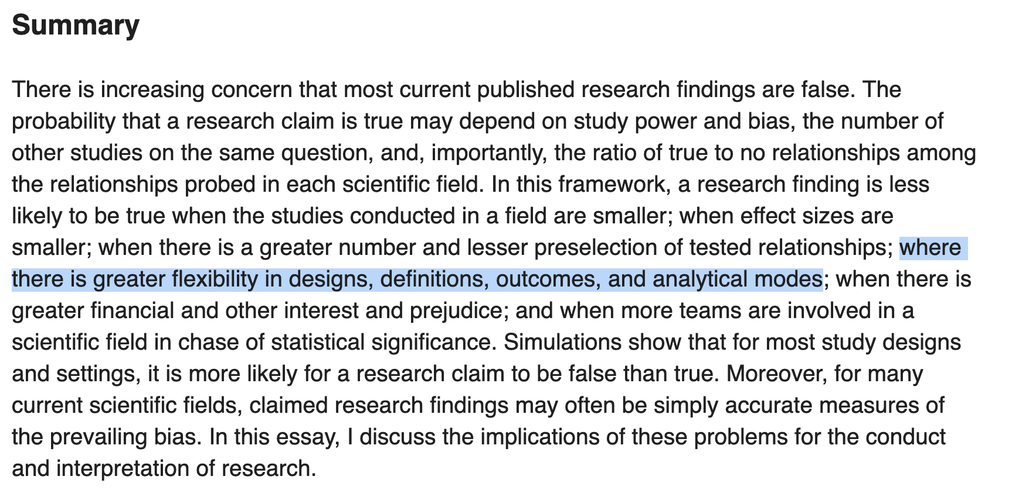
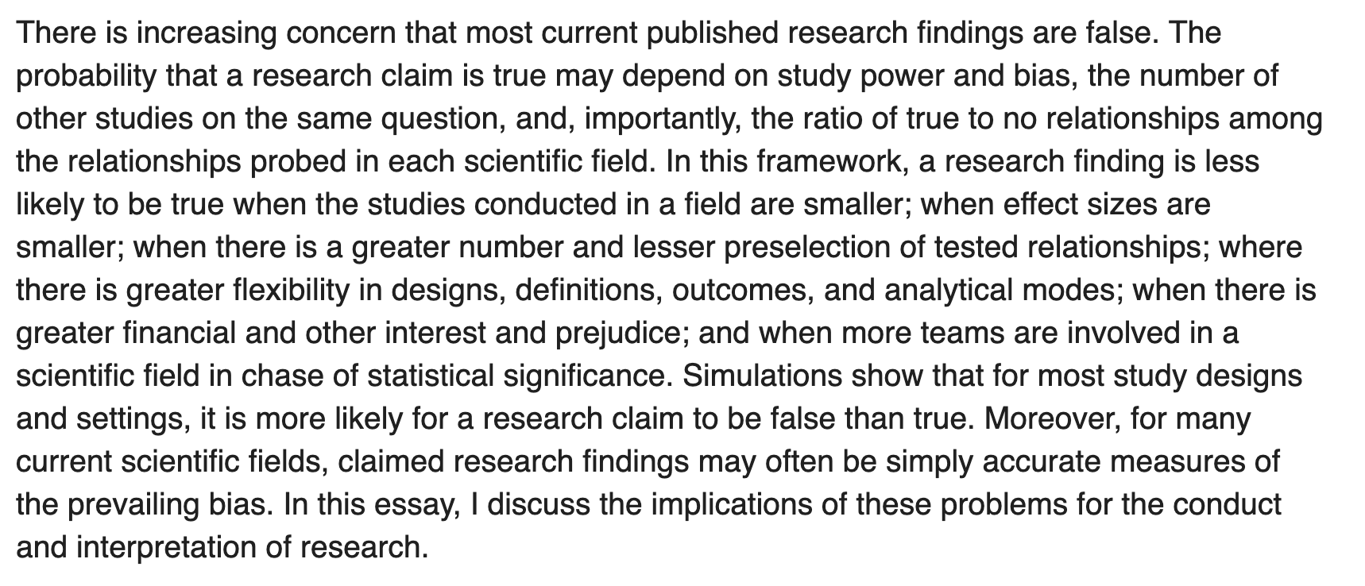


Notes:
Let’s come back to Ioannidis, who might have had a point:
The decisions along the way in the research process might be important
Poor decisions, if intended or not, might lead to false positives

Slide 9
An example of how to create false positives
If you want to hit the p<0.05, you will
E.g. by:
Sequentially testing while excluding participants
(However, that inflates the rate of false positives)
Notes:
There are hundreds of ways of analysing your data.
You can exclude participants based on the severity of symptoms, absence of such, or our daily humor.
If you want to reach a p-value smaller 0.05, you can, if you torture the data hard enough, or search long enough.
But it can also be that you chose a suboptimal analysis pipeline and there are better or at least other ways of analysing your data
Well, how would you know that you have the best approach?

Slide 10

all
Notes:
To avoid this innate bias, you can run al analysis you can come up with AND REPORT THEM
If there is a false-positive literature... who to trust?
And should anybody trust you? Since we know than not all analyses are being reported...
«Trust is good, control is better» (Lenin(?))

Slide 11

How?
Notes:
Ok, but how to do «all» analyses?
Of course you cannot do all. But you specify a plausible and computable selection of analyses.

Slide 12
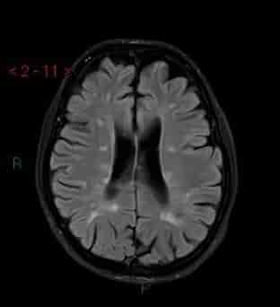
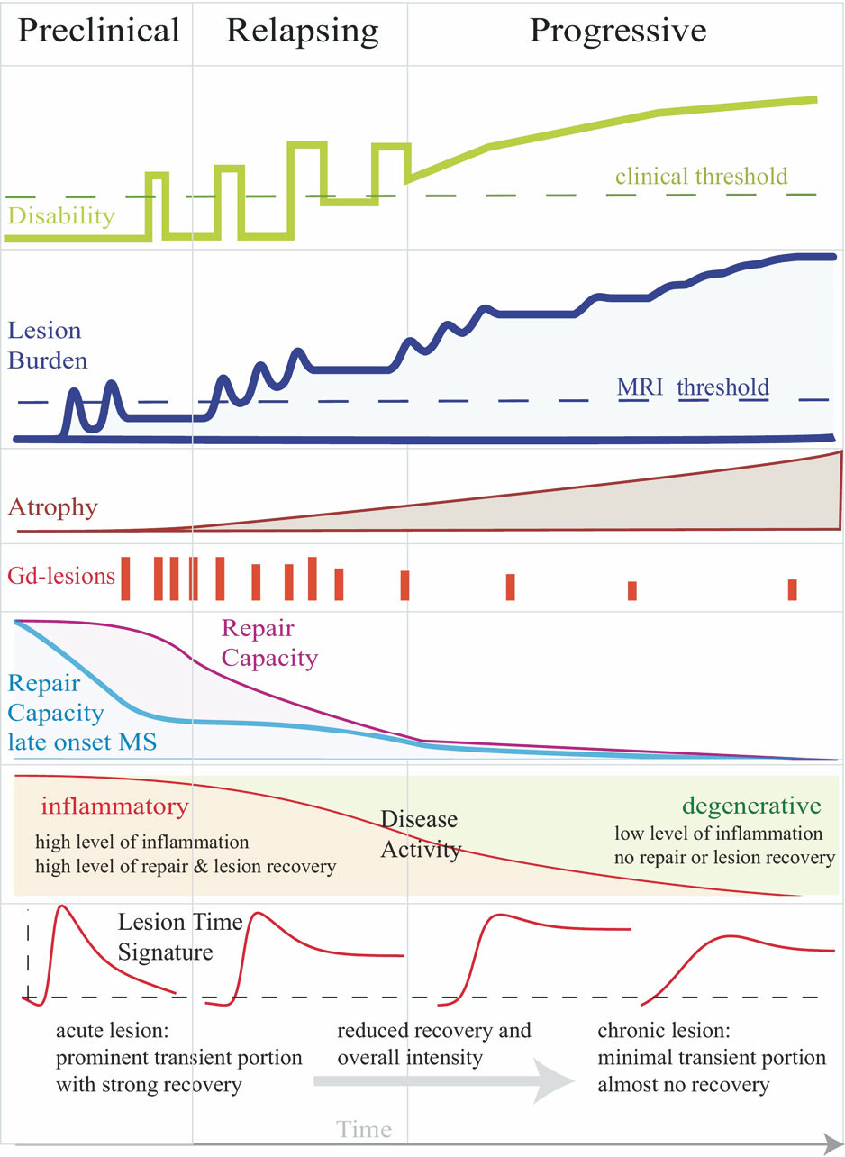
Example: Precision medicine for MS?
Unclear when what happens exactly in which order, with which variability, and how to measure it
Some challenges:
Lesions are used dignostically, yet unclear what role they play in patients’ worsening
MS is an inflammatory disease, but we struggle with pinpointing a subset of inflammatory markers to the disease or its stages
Images from https://radiopaedia.org/articles/multiple-sclerosis & Meier et al. (2006). Neurotherapeutics 4(3).
Notes:
You might wonder how this is valuable to you or your research.
Let’s take a practical example of MS, where we know there are many limitations in our understanding of the progression of the disease
It is crucial to explore many pathways, which also leaves many loose ends.
Examples are
the role of lesions for progression (see top image)
Or reliable inflammation markers which correspond with conceptualisations of progression

Slide 13
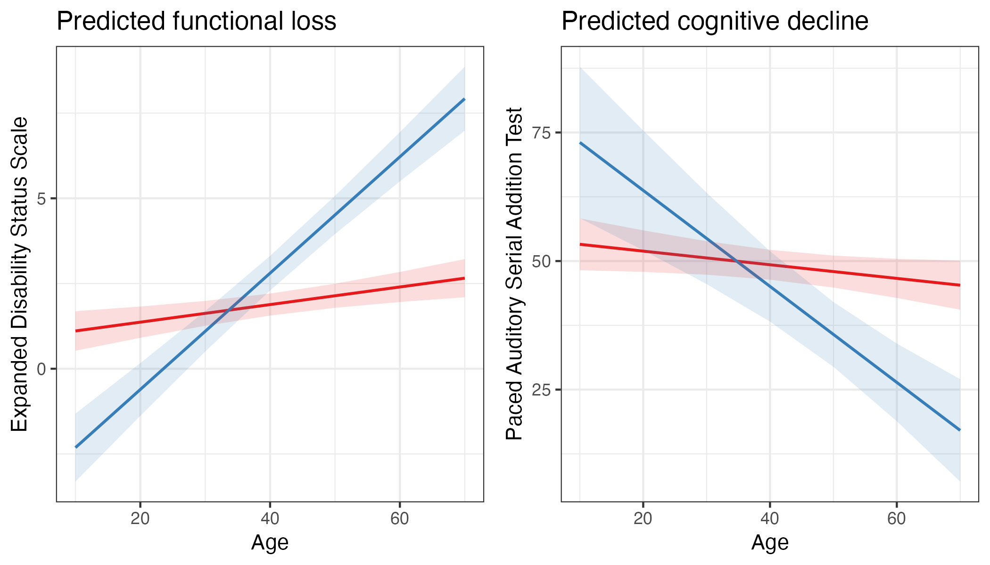
Example: Precision medicine for MS
Important question: what predicts functional and cognitive decline early on?
N=85 pwMS with a 12-year follow-up
Mean age of 38.9±8.3 (range: 19-58) years at baseline and 49.6±8.6 at the final follow-up
65.9% females
Reaching and declining beyond EDSS≥4
Declining ≥25% from the maximum cognitive score (PASAT)
Notes:
Besides all the unclarities, there remains one essential question:
What explaines negative trajectories of pwMS, meaning functional and cognitive decline
We looked at longitudinal data being the follow-up of a clinical trial to group pwMS into two groups of those who get worse and those that are stable.
Two analyses
functional loss: clinically confirmed EDSS≥4, worsening towards 12-year follow-up
cognitive decline: 25% Paced Audiory Serial Addition Test (PASAT) score decline
The plots are the regression lines for linear mixed effect models showing that the groupings into differentiable groups worked.

Slide 14
What data to look at?
Magnetic resonance imaging
“Omics”
Clinical measures
Patient reported outcome measures (PROMs)
Vitamin levels
Demographics
Notes:
There are many variables of interest outlined in the literature with the potential to predict functional and cognitive decline which we have available
MRI
Lesions, atrophy, machine learning derivatives: brain predicted age
Omics
Proteomics: neurofillament lightchain, CH3L1
Genomics: HLA-DRB1 carriers
Clinical scores
Expanded Disability Status Scale (EDSS)
Paced Auditory Serial Addition Test (PASAT)
Patient reported outcome measures (PROMS)
Vitamin A, D, E levels, smoking status, age, treatment with omega 3 fatty acids during clinical trial

Slide 15
What data to look at?
Many studies in the field:
Magnetic resonance imaging
“Omics”
Clinical measures
Patient reported outcome measures (PROMs)
Vitamin levels
Demographics
Notes:
Remember, traditional studies usually look at only one or a few of these variables
For example: «How does the number of relapses correlate with our cognitive score?»
However, already in this picture, there are more than 3 million trillions of combinations possible
Not all of them might make sense, so we kept it to 1.7 million logistic regression models which were used to classify patients at baseline who will have poor outcomes over time

Slide 16
What data to look at?
Formalising this somewhat mathematically
Y = b₀ + b₁X₁ + … + b_{i}X_{i} + e
How will the patient do?
The change in clinical measures
(EDSS, cognitive scores)
Based on “stuff” we measure
Magnetic resonance imaging
“Omics”
Patient reported outcome measures (PROMs)
Vitamin levels
Demographics
Notes:
Let’s formalise this mathematically

Slide 17
3. Multiverse analysis
Y = b₀ + b₁X₁ + … + b_{i}X_{i} + e
Notes:
What we presented was a saturated model.
We throw in all variables we have
But there are many problems connected to this procedure and we cannot be sure whether our results will be due to the selection of variables we did
Multicollinearity (can induce false correlations)
Researcher bias

Slide 18
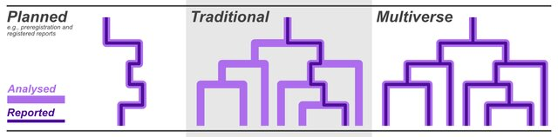
3. Multiverse analysis
Image from Marshall & Duthie (2024). bioRxiv
Y = b₀ + b₁X₁ + … + b_{i}X_{i} + e
Notes:
So this would usually be a single regression model with some linear combination of predictors.
You can plan such analyses by registering analyses before seeing the data and report the results
In my case: 369,512 linear regression models (can be computationally costly)

Slide 19
How to report a million regression models?
Median p-value
Median effect±MAD (right figure)
Proportion of effects with the same sign
Notes:
But how to report millions of regression models?
By using median and median absolute deviation values of the desired metrics, such as area under the curve, p-values or odds ratio

Slide 20
Two multiverse analyses
Notes:
In the case of our study that would be predicting the membership of either the functional or cognitive decline group
Now, notice that whiskers crossing an odds ratio = 1 does not mean non-significant, since we are talking about thousands of effects

Slide 21
Two multiverse analyses
Notes:
The most interesting effects which were robust to different controls, such as removing low-power models, were EDSS, PASAT, relapses the year prior to baseline, vitamin A levels and self-reported mental health and physical functioning
Note, however, that only functional loss group membership could be sufficiently predicted, on average (mAUC=0.72±0.05)
Cognitive loss: mAUC=0.56±0.06

Slide 22

Conclusions
MS-related. Best predictors for risk-group stratifications of people with MS at baseline:
Clinical assessments (physical fct, cognition, prior relapses)
Self-reported health
Vitamin A levels (?)
Generally. We observe strong variability based on modelling choices.
Transparency is key when reporting study findings.
Alternatively, use strategies which are robust to the many researcher degrees of freedom
To the preprint:
Notes:
MS-related. Best predictors for risk-group stratifications of people with MS at baseline:
clinical assessments of physical function and cognition
prior relapses
self-reported mental health
potentially vitamin A levels >> PERHAPS SOMETHING ELSE THAN SAMPLE BIAS??
Generally. We observe strong variability based on modelling choices.
Transparency is key when reporting study findings.
Alternatively, use strategies which are robust to the many researcher degrees of freedom

Slide 23
Functional Loss
EDSS (0-10): 100% of effects in same direction, OR_{median}=2.15±0.51, p_{median}=.113
That means there is a 115% increase in the odds of being in the functional loss group = doubled risk for every 1-point higher EDSS at baseline
PASAT (60-0): 1000% of effects in same direction,
QoL PROM physical functioning (0-100), 84.45% of effects in same direction, OR_{median} =0.99±0.01, p_{median} =0.483

Slide 24
99.76% of effects are positive, Md b = 0.13, Md p = 9.54*10⁻¹²
92.78% of effects are negative, Md b = -0.40, Md p = 1.59*10⁻¹⁴⁹
Example of an unclear effect:
35.19% of effects are positive, Md b = 0.09, Md p = 1.47*10⁻¹⁵
49.60% of effects are positive
Conclusions: Baseline EDSS, Vitamin A, and PROMs, as well as nb relapses 12 months prior, can predict the decline in cognitive performance of MS patients measured by the Paced Auditory Serial Addition Test.
Notes:
Let’s walk through the results, and check interesting values
PASAT-score decrease of 2.17 points in the 10-year period (t(75)=-2.23,p=0.028).

Slide 25







Thank you for your attention!
How to contact me:
max.korbmacher@helse-bergen.no
Again, the preprint >>
Notes:
Thank you for your attention and the Neuro-SysMed group!
Please reach out, for questions or collaboration.

Slide 26
Brain age

Slide 27
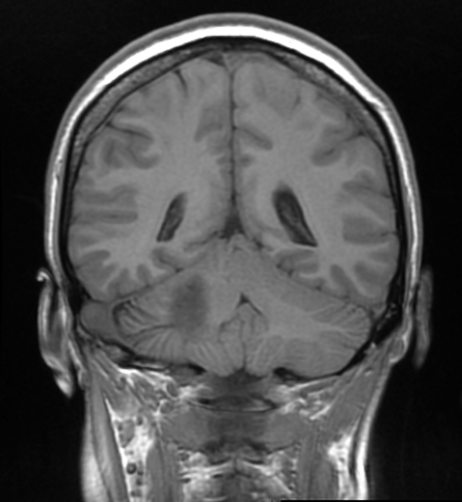
Brain age
1) Model training
Training model
Predicting chronological age with that model
Differences between brain age and chronological age
Individuals of different ages
Trained model
2) Predictions
Model applied to individual data
Brain age:
27 years old
Example individual.
Chronological age:
22 years
Difference / Brain age gap: 5 years
Notes:
Besides classical age-associations, one can use brain age
For that one trains a model, usually using machine learning on magnetic resonance images
This model is then used to make individual predictions, “a best guess” about the age of a person based on their brain
This can be done using different brain features and scales, from the voxel/pixel level to reconstructed features such as grey matter thickness in a brain region
Multiple studies indicate that the difference between chronological and brain age (the brain age gap) indicates multiple health outcomes and diseases

